Slide 1


AUTOMATION OF SOLAR PANEL CLEANING SYSTEM ENABLED WITH MONITERING AND CONTROLLING APPLICATION
Dayananda Sagar University
School of Engineering
Department of Electronics & Communication Engineering
Presented By
TOUHEED KAZMI- ENG16EC0092
VISHAL G YADAV- ENG16EC0095
MOHAMMED YAQUB G S- ENG17EC1005
AVINASH S N –ENG17EC1001
Guided By
Dr. PAYAL VERMA
Dayananda Sagar University School of Engineering Bengaluru-560068, India

Slide 2
CONTENTS
INTRODUCTION
VISIBLE FACTORS AFFECTING SOLAR PANEL
CONVENTIONAL METHODS OF CLEANING AND MONITORING
PROPOSED SOLUTION
METHODOLOGY
MAIN PROGRAM
MOBILE APPLICATION FOR REMOTE MONITORING PURPOSE
CONCLUSION
REFERENCES

Slide 3
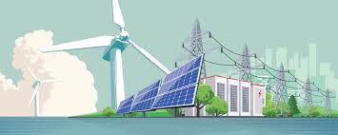
INTRODUCTION
RENEWABLE RESOURCES ?
Fig 1. Animated picture of Renewable Resources

Slide 4
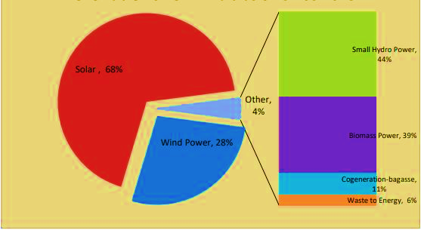
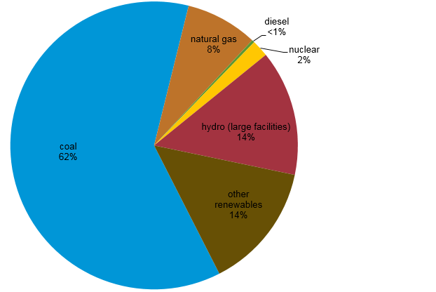
STATS
Fig 3. POTENTIAL OF RENEWABLE POWER
Fig 2. COMBINED ENERGY RESOURCE USAGE IN INDIA 2019

Slide 5
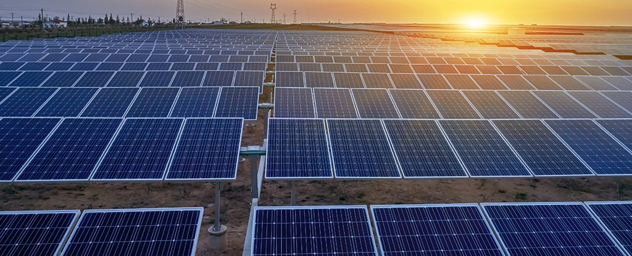
SOLAR CELL ?
Fig 4. Photo Image of large scale solar panels

Slide 6
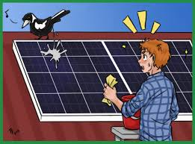
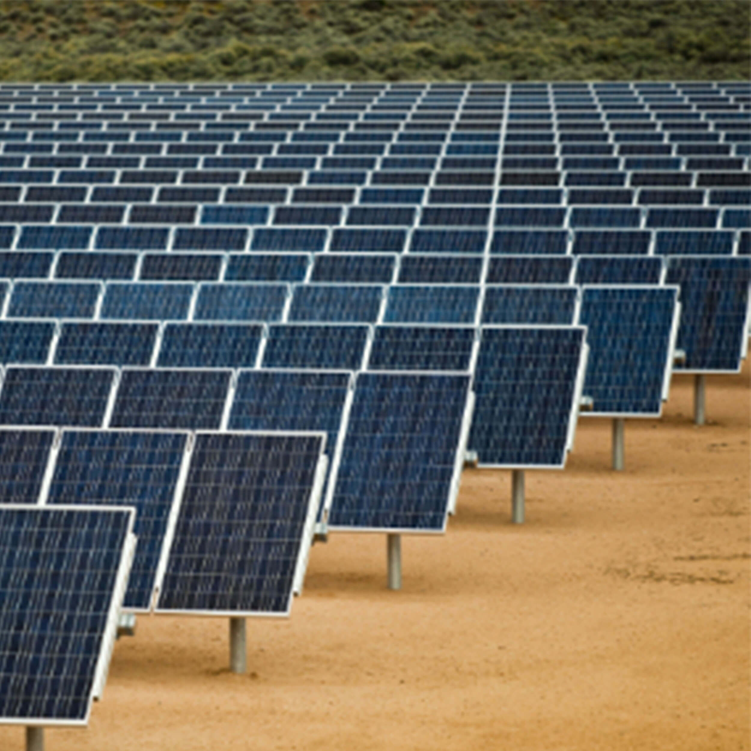
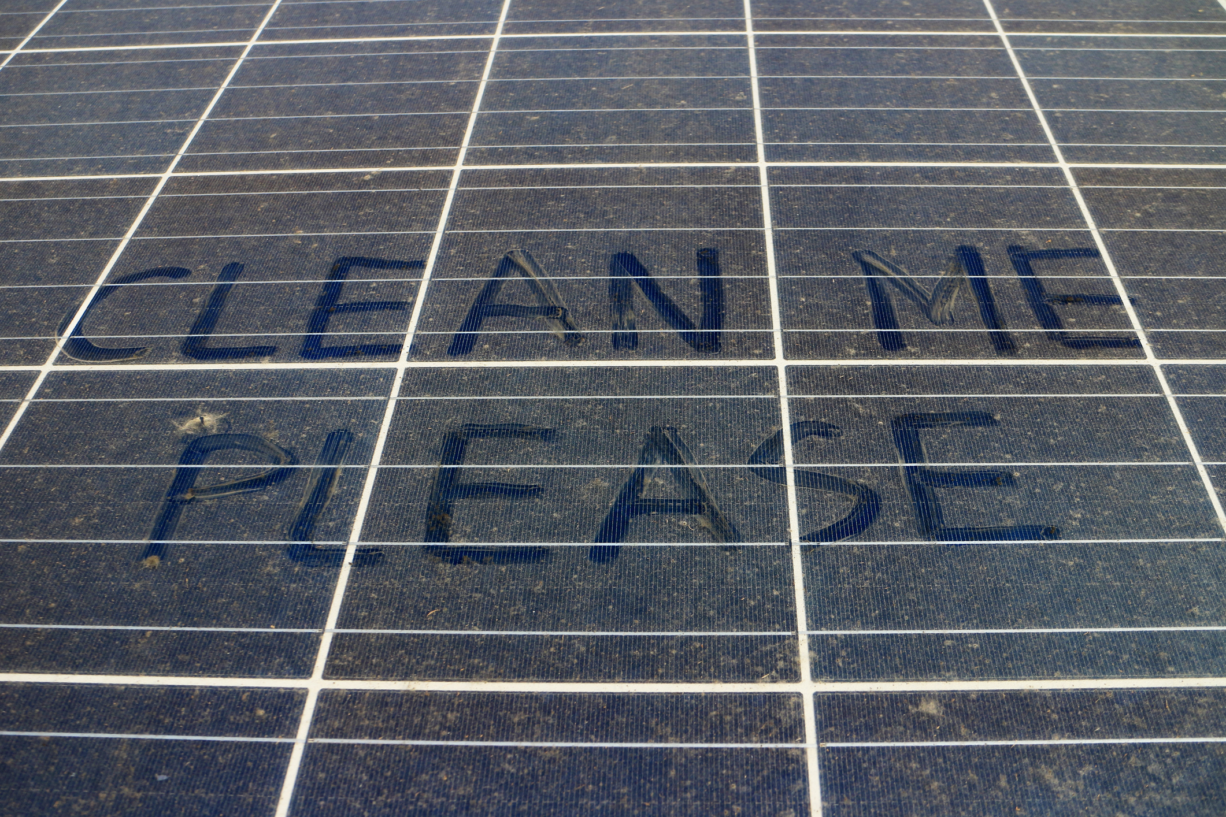
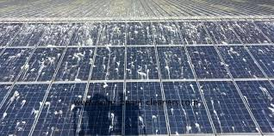
Visible factors affecting solar panel
Fig 6. Bird poop on solar panel
Fig 5. Dust particle accumulation on solar panel
Fig 8. Sand particles on solar panel
Fig 7. sea salt particles on solar panel

Slide 7
Why clean ?
The solar PV modules are generally employed in dusty environments which is the case in tropical countries like India. The dust gets accumulated on the front surface of the module and blocks the incident light from the sun. It reduces the power generation capacity of the module. The power output reduces as much as by 50% if the module is not cleaned for a month.

Slide 8
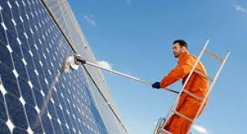
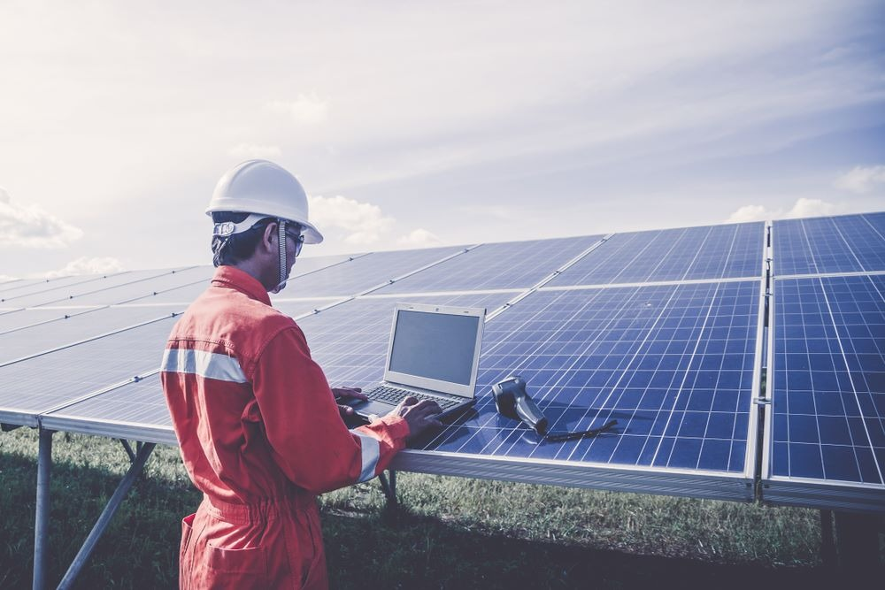
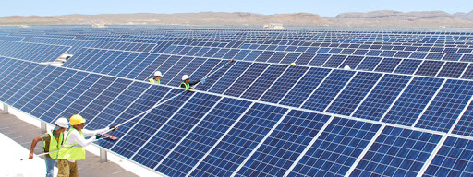
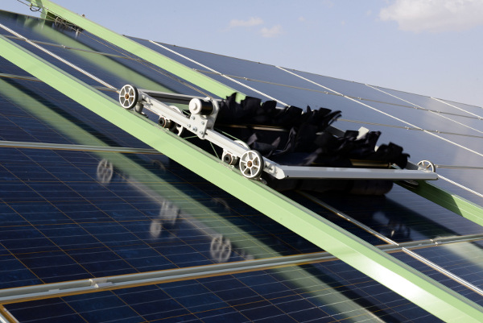
conventional methods of cleaning and monitoring
Fig 9. Manual employee involved in wiping with water broomstick
Fig 11. Manual monitoring of solar panel
Fig 12. manual dusting stick involved in cleaning
Fig 10. Robotic dust Cleaning conventional belt mechanism

Slide 9
disadvantages
Water consumption is very high
Increased Labor cost
Increased time to clean
Sometimes not reachable for all modules
Efficiency is low
Hard work for human and need them all the time

Slide 10
Proposed solution
The cleaning system has been designed, cleans the module by moving a robotic cleaning system. The system consists of a Robot with water spraying system and dusting system. To clean the solar panel efficiently first Robot cleans the dry dust using dusting/wiping system, later it starts the spraying system along with wiping system to clean hard dust. To make dust not to accumulate last, the system needs to operate at a regular interval. This makes dust not to accumulate long time and get hardened

Slide 11
advantages
Water consumption is low
No Labor
Reduced cleaning time
High efficiency
No need of human for field work

Slide 12
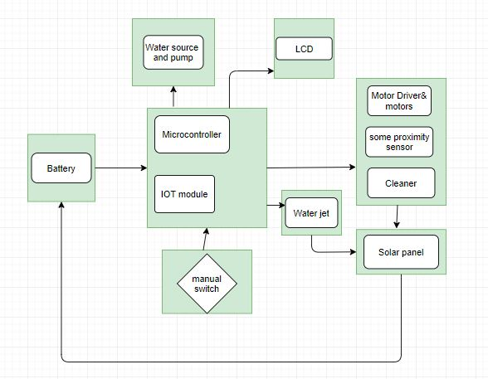
methodology
Fig 13. Block diagram of the proposed solution

Slide 13
Main program
if(Solar_state==1)
{
if(count<12)
{
if(digitalRead(17)==LOW)
{
digitalWrite(4,LOW);
digitalWrite(5,LOW);
delay(300);
digitalWrite(4,LOW);
digitalWrite(5,HIGH);
delay(300);
if(count<6)
{
delay(100);
digitalWrite(2,LOW);
}
else
{
delay(100);
digitalWrite(2,HIGH);
}
}
else if(digitalRead(15)==LOW)
{
digitalWrite(4,LOW);
digitalWrite(5,LOW);
delay(300);
digitalWrite(5,LOW);
digitalWrite(4,HIGH);
delay(300);
}
}
else
{
Solar_state=0;
system_op=0;
switch_pressed=0;
count=0;
digitalWrite(2,HIGH);
digitalWrite(4,LOW);
digitalWrite(5,LOW);
digitalWrite(6,LOW);
digitalWrite(7,LOW);
}
}
#include<p18f4520.h>
#include <LiquidCrystal.h>
#include <RTClib.h>
#define Green_LED 14
unsigned long previousMillis = 0;
const long interval = 20000;
unsigned int Battery_Voltage=0;
unsigned int Solar_Voltage=0;
unsigned char state=0;
unsigned char last_state=0;
unsigned char button_last_state=1;
unsigned char button_state=1;
unsigned char count=0;
unsigned char switch_pressed=0;
unsigned char current_min=0;
unsigned char Solar_state=0;
unsigned char Battery_Voltage_decivolts, Battery_Voltage_volts,Solar_Voltage_volts,Solar_Voltage_decivolts;
int Battery_Voltage_f=0;
int Solar_Voltage_f=0;
unsigned char system_op=0;
#define DEBUG false
RTC_DS1307 rtc;
LiquidCrystal lcd(3,10,9,11,12,13);
void setup()
{
pinMode(2,OUTPUT);
pinMode(15,INPUT_PULLUP);
pinMode(17,INPUT_PULLUP);
digitalWrite(2,HIGH);
pinMode(6,OUTPUT);
pinMode(7,OUTPUT);
pinMode(8,INPUT_PULLUP);
digitalWrite(4,LOW);
digitalWrite(5,LOW);
delay(2000);
lcd.begin(16, 2);
lcd.clear();
lcd.setCursor(0, 0);
lcd.print("LCD");
lcd.setCursor(0, 1);
lcd.print("Initialised");
delay(2000);
lcd.clear();
lcd.setCursor(0, 0);
lcd.print("System");
lcd.setCursor(0, 1);
lcd.print("Initialising");
delay(2000)
pinMode(Green_LED,OUTPUT);
rtc.begin(); // rtc begin
lcd.clear();
lcd.setCursor(0, 0);
lcd.print("CLOCK");
lcd.setCursor(0, 1);
lcd.print("Initialiasing");
delay(1000);
Read_Time();
delay(1000);
lcd.clear();
lcd.setCursor(0, 0);
lcd.print("CLOCK");
lcd.setCursor(0, 1);
lcd.print("Initialiased");
Serial.begin(115200);
delay(1000);
lcd.clear();
lcd.setCursor(0, 0);
lcd.print("WiFi");
lcd.setCursor(0, 1);
lcd.print("Initialiased");
Start_Server();
lcd.clear();
lcd.setCursor(0, 0);
lcd.print("Server");
lcd.setCursor(0, 1);
lcd.print("Started....");
delay(1000);
lcd.clear();
lcd.setCursor(0, 0);
lcd.print("Solar");
lcd.setCursor(0, 1);
lcd.print("Panel Cleaner");
delay(1000);
}
void loop()
{
int Battery_Value;
int Solar_Value = analogRead(A2);
Solar_Voltage_volts=0;
Battery_Voltage_volts=0;
Battery_Voltage_f = Battery_Value * (5.0*11.0 / 1023.0);
for(Battery_Voltage_decivolts=(Battery_Value*10*(5.0*11.0 / 1023.0)); Battery_Voltage_decivolts>=10; Battery_Voltage_decivolts-=10)
{
Battery_Voltage_volts++;
}
Battery_Voltage_volts=5;
Battery_Voltage_decivolts=1;
Battery_Voltage_f=5.1;
Solar_Voltage_f = Solar_Value * (5.0*110.0 / 1023.0);
for(Solar_Voltage_decivolts=Solar_Voltage_f; Solar_Voltage_decivolts>=10; Solar_Voltage_decivolts-=10)
{
Solar_Voltage_volts++;
}
unsigned long currentMillis = millis();
if ((unsigned long)(currentMillis - previousMillis) >= 5000 && system_op==0)
{
previousMillis = millis();
Send_Data();
}
button_last_state=button_state;
button_state=digitalRead(8);
if((button_last_state!=button_state) && button_state==LOW)
{
switch_pressed=1;
}
last_state = state;
state = digitalRead(17);
if(last_state != state)
count++;
if(switch_pressed==1 || current_min==1 || current_min==15 || current_min==30 || current_min==45)
{
Solar_state=1;
system_op=1;
}

Slide 14
Read_Time();
delay(300);
}
char current_time[6];
unsigned int current_year;
int connectionId=0;
void Read_Time()
{
DateTime now = rtc.now();
current_time[2] = (now.hour());
current_time[1] = (now.minute());
current_time[0] = (now.second());
current_min = current_time[1];
lcd.clear();
lcd.setCursor(0, 0);
lcd.print("Cur Time ");
lcd.print(current_time[0],DEC);
lcd.print(":");
lcd.print(current_time[1],DEC);
lcd.print(":");
lcd.print(current_time[2],DEC);
lcd.setCursor(0, 1);
lcd.print(Battery_Voltage_volts,DEC);
lcd.print('.');
lcd.print(Battery_Voltage_decivolts,DEC);
lcd.print('V');
lcd.setCursor(8, 1);
lcd.print(Solar_Voltage_volts);
lcd.print('.');
lcd.print(Solar_Voltage_decivolts);
lcd.print('V');
}
//gets the data from esp//
void sendData(String command, const int timeout, boolean debug)
{
String response = "";
Serial.print(command);
long int time = millis();
while( (time+timeout) > millis())
{
while(Serial.available())
{
char c = Serial.read(); // read the next character.
response+=c;
}
}
}
//sends data from ESP to webpage//
void espsend(String d)
{
String cipSend = F(" AT+CIPSEND=");
cipSend += connectionId;
cipSend += ",";
cipSend +=d.length();
cipSend +="\r\n";
sendData(cipSend,1000,DEBUG);
sendData(d,1000,DEBUG);
}
void Start_Server()
{
sendData(F("AT+RST\n"),2000,DEBUG); // reset module
sendData(F("AT+CWMODE=2\n"),1000,DEBUG); // configure as access point
sendData(F("AT+CIPAP=\"192.168.45.100\",\"192.168.45.1\",\"255.255.255.0\"\n"),1000,DEBUG);
sendData(F("AT+CIFSR\r\n"),1000,DEBUG); // get ip address
sendData(F("AT+CWSAP=\"Solar_Panel\",\"\",1,0,4,0\n"),1000,DEBUG); // get ip address
sendData(F("AT+CIPMUX=1\n"),1000,DEBUG); // configure for multiple connections
sendData(F("AT+CIPSERVER=1,5555\n"),1000,DEBUG); // turn on server on port 80
}
void Send_Data()
{
String data;
data =String(Battery_Voltage_volts);
data +=(';');
data +=String(Battery_Voltage_decivolts);
data +=(';');
data += String(Solar_Voltage_volts);
data +=(';');
data += String(Solar_Voltage_decivolts);
data +=(';');
espsend(data);
}

Slide 15
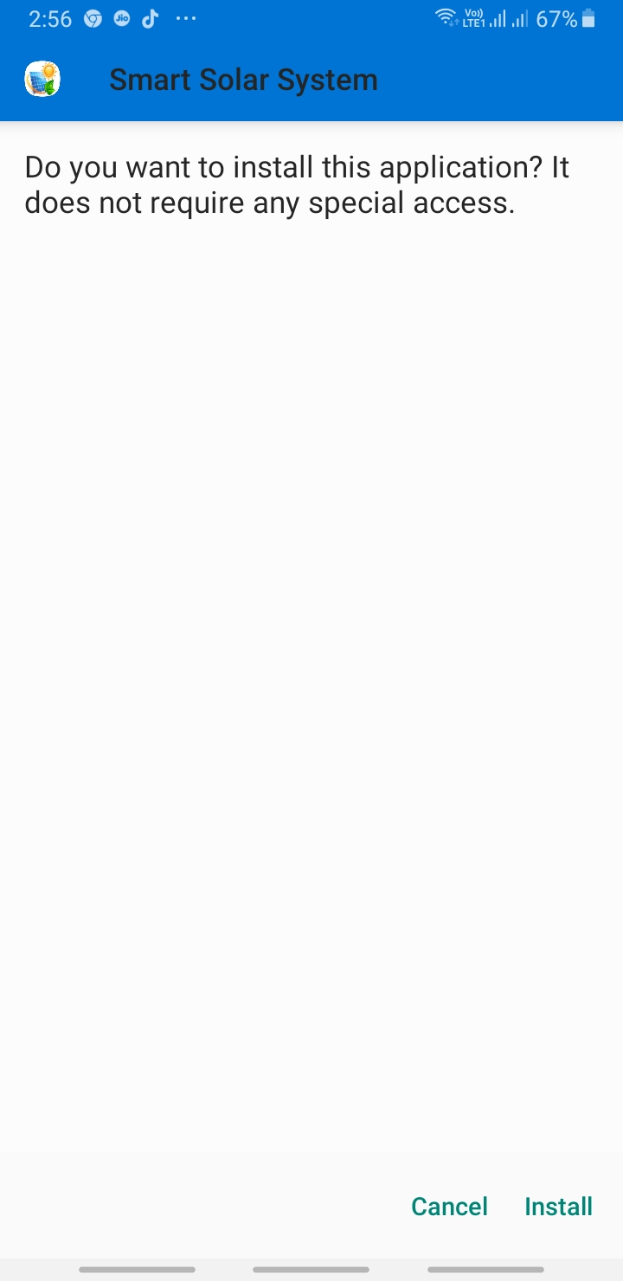
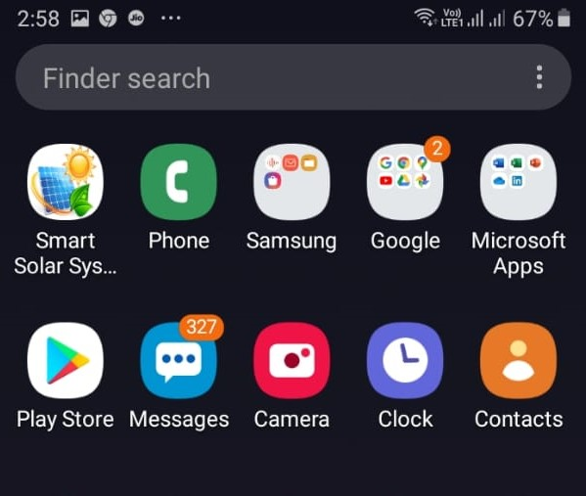
Mobile application for remote monitering purpose
Fig 14. Installation of the application
Fig 15. Smart Solar System application

Slide 16
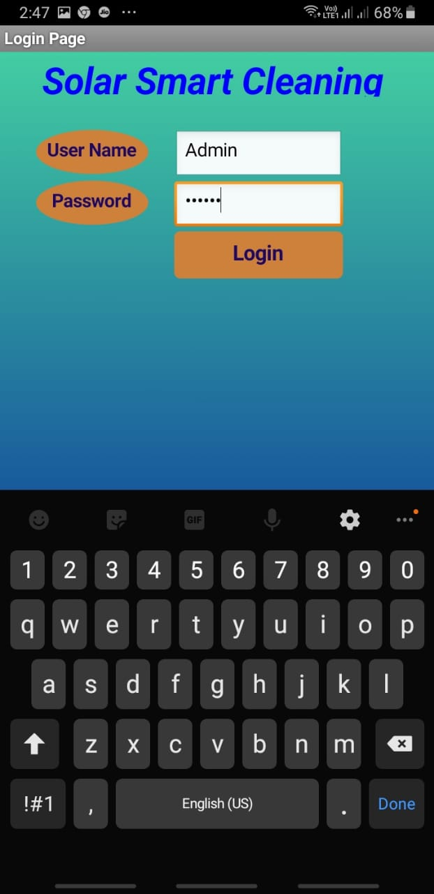
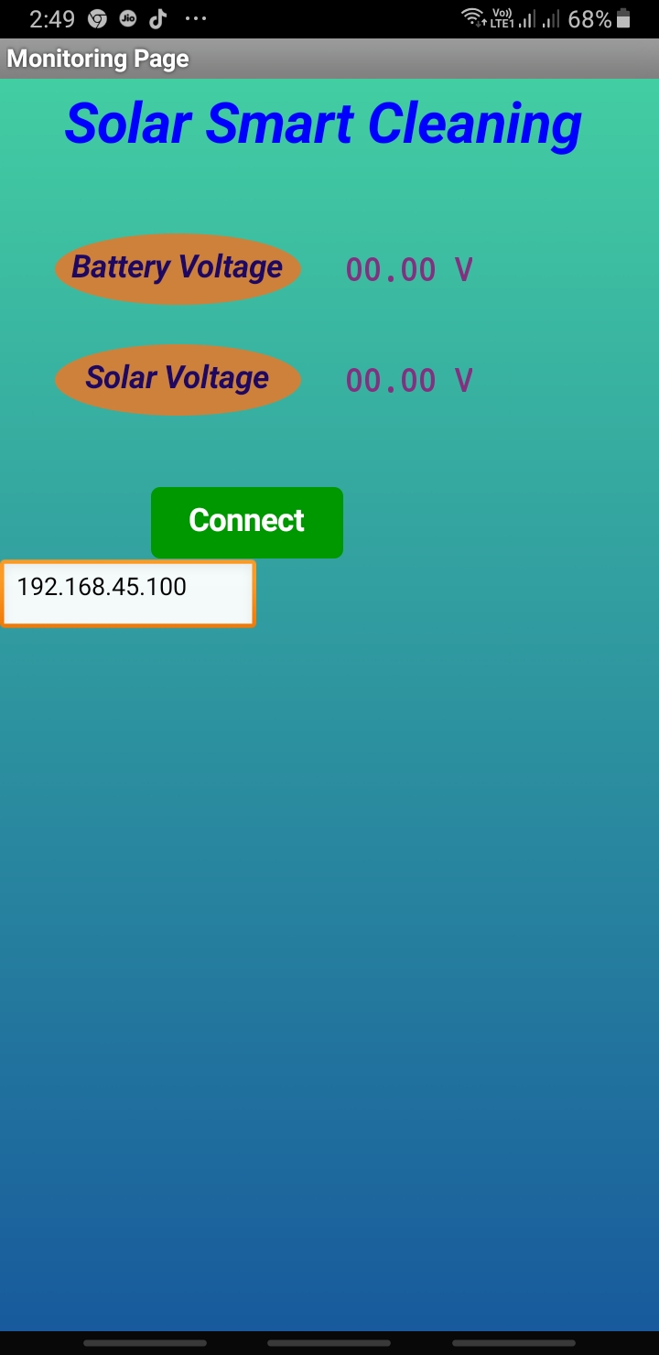
Fig 16. Login page of the application
Fig 17. Remote Monitoring values

Slide 17
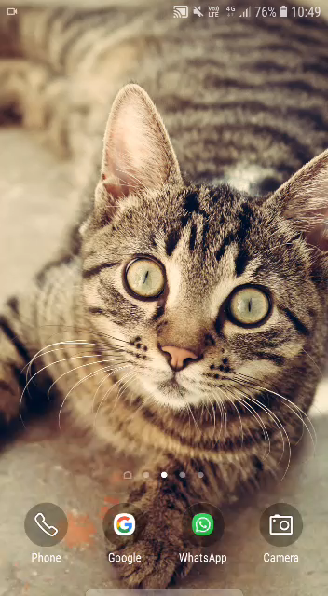
Android Application

Slide 18
conclusion
The Solar panel cleaning system would clean the Solar panel at a specified time. The cleaning system is also controlled and monitored by an IOT application installed in any of the Android mobile. This system would enable solar panel to convert solar energy to electrical energy with full efficiency.

Slide 19
references
[1] Ashish Saini and Abhishek Nahar .Solar Panel Cleaning System. ijir.2017; 3(5):1222-1226.
[2] satishpatil, mallaradhya h m.design and implementation of microcontroller based automatic dust cleaning system for solar panel.ijerat.2016; 2(1):187-190.
[3] Dr.G.Prasanthi ME, Ph.D., T.Jayamadhuri. Effects Of Dust On The Performance Of Solar Panel And Improving the Performance By Using Arm Controller And Gear Motor Based Cleaning Method.IJISET.2015;2(9):329-334.
[4] Aditya Sinha. Automatic Solar Tracker with Pre-Installed Panel Cleaner.ijariit.2017; 3(5):232-238.

Slide 20

Thank You!

